Slide 1
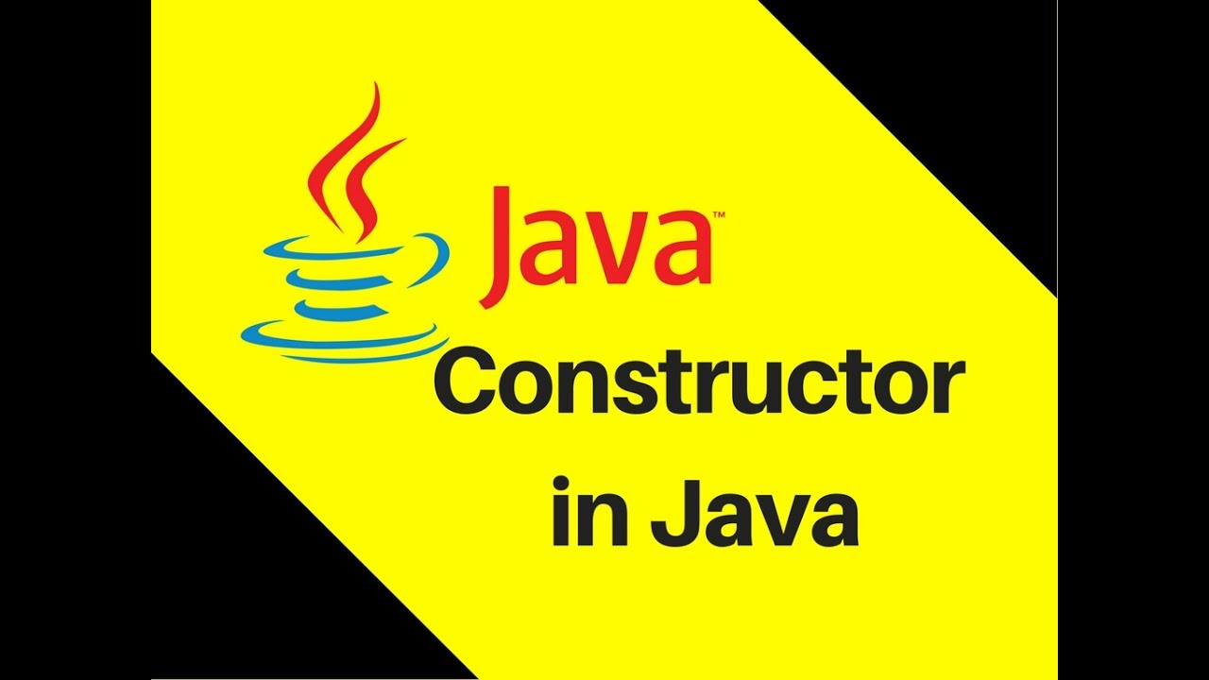

Sarower Ahmmed

Slide 2
Constructor
Constructor in java is a special type of method that is used to initialize the object.
Java constructor is invoked at the time of object creation.
It constructs the values i.e. provides data for the object that is why it is known as constructor.

Slide 3

Contractor -construct value
Class
Create Object
Construct give Value in object state/ Variable

Slide 4
Why Java need Constructor?
Constructors are used to initialize the instances/object of your classes.
A constructor invoke automatically when a object is created
A class contains constructors that are invoked to create objects from the class blueprint
Initialization is a process of assigning user defined values at the time of allocation of memory space.

Slide 5
Rules for creating java constructor
Constructor name must be same as its class name
Constructor must have no explicit return type/ no void

Slide 6
What do Constructors look like in Code?
Here below Sum class has Sum() constructor
class Sum {
Sum() {
}
public static void main(String s[]) {
Sum s=new Sum();
}
}

Slide 7
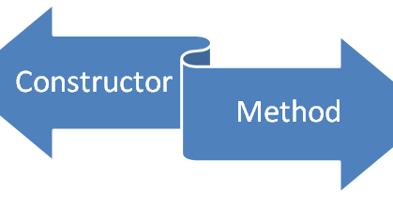
Is constructor like class or like method?
Constructor in Java is a special member like a method

Slide 8
POINTS | Java Constructor | Java Method
Purpose | Initialize the state of an object. | Expose behavior of an object.
Return type | No return type, not even void | void or a valid return type
Invoke | Constructor is invoked implicitly/ automatically | Method is invoked explicitly.
Default constructor | The JVM provides a default constructor if you don't have any constructor. | Method is not provided by compiler in any case.
Name | Constructor name must be same as the class name. | Method name may or may not be same as class name.
Modifiers | Cannot be abstract, final, native, static, or synchronized | Can be abstract, final, native, static, or synchronized
Inheritance | Constructors are not inherited | Methods are inherited
This words | This word to another constructor in the same class. If used, it must be the first line of the constructor | This Refers to an instance of the owning class. Cannot be used by static methods
Super words | Calls the constructor of the parent class. If used, must be the first line of the constructor | Calls an overridden method in the parent class

Slide 9
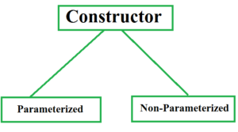
Types of java constructors
Default constructor (no-arg constructor)
Parameterized constructor/ argument constructor

Slide 10
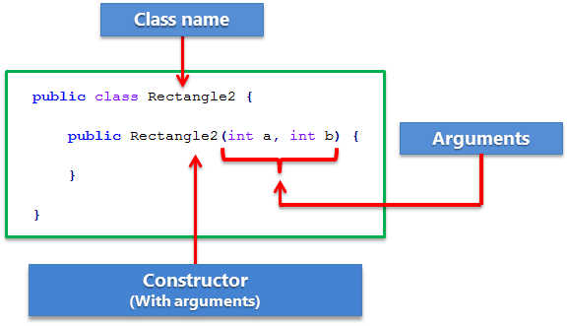
Constructor model in java: Same as object create from class
Same as class name , but it is like a method.
No void
If no parameter- Default
With parameter- Parameterized

Slide 11
Default constructor
A constructor that have no parameter is known as default constructor.
Even default constructor created by JVM if no constructor created.
It provide default value of variable/ obj state, like-
Int variable value=0
Double =0.0
String=null

Slide 12
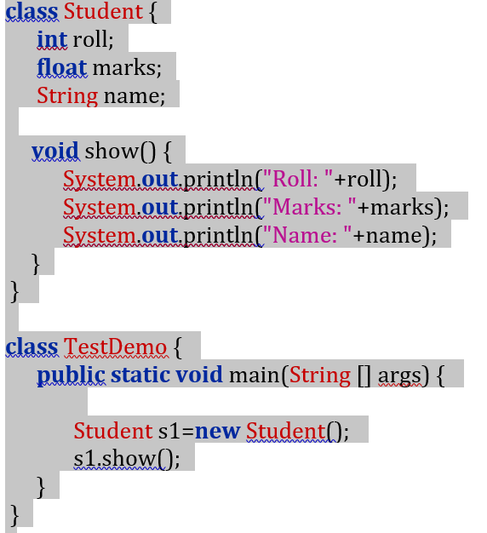
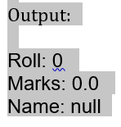
Example of default constructor that displays the default values:

Slide 13
How Constructor eliminates default values?
Same as variable initialization and remove default value

Slide 14
Parameterized constructor: If any constructor contain list of variable in its signature is known as parameterized constructor.

Slide 15
Constructor Overloading
A class can have any number of constructors that differ in parameter lists.
In general constructor overloading can be used to initialize same or different objects with different values.

Slide 16
Over loading of constructor

Slide 17
Why overriding is not possible at constructor level.
Overriding means extends parent class to child class and use same parent methods in child.
Constructor cant inherited from one class to another class
So Overriding of constructor not possible.

Slide 18

Brain capacity is beyond your imagination.
The more you use your brain,
the more brain cell will be active.

